Slide 1
Text-Prediction Using Recurrent Neural Networks

Slide 2
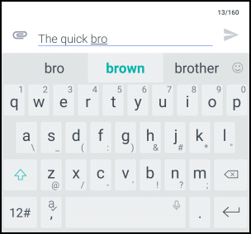
What is Text Prediction?
Text Prediction is the art of prophesying what the next word of a sentence (or text) will be given a certain number of words in the past
Notes:
We decided that text prediction would be an interesting application of RNNs. It’s very relevant and something we see every day on our phones and also links into other topics like text generation, where you can eventually have your program write stories or long paragraphs of text.

Slide 3
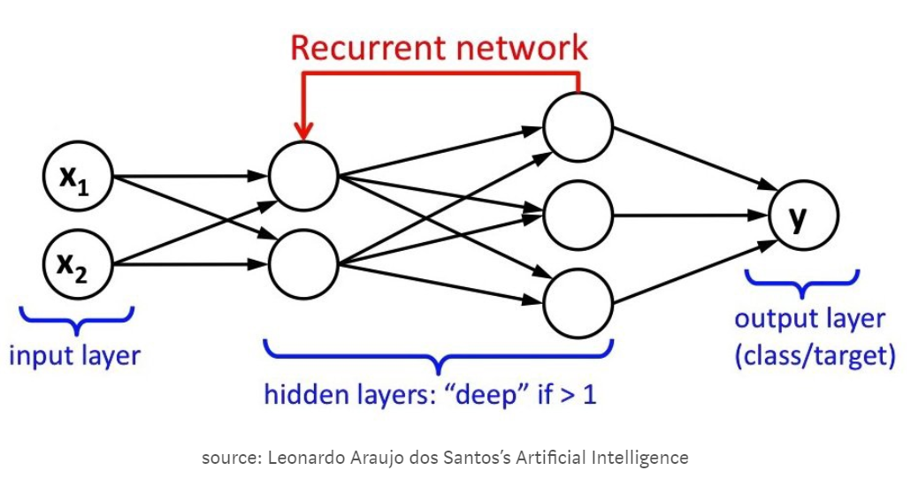
What is an RNN?
Notes:
RNNs aim to mimic human learning by building off of previous input rather than restarting every time new information comes in. The loops in the network allow it to make use of sequential information, so every new step is informed by those inputs that came before it. The program retains a “memory” of the previous steps.
RNNs are particularly good at sentiment analysis, so analyzing positive versus negative reviews, and also detecting spam texts or emails or image captioning.
One downfall to RNNs: You can see from the previous graph how all the connections between layers and steps can quickly multiply and get very complex. This makes calculating the gradient problem very confusing, and leads to a problem called the vanishing or exploding gradient. Often, the model ends up over or under accounting for the weight of each step.

Slide 4
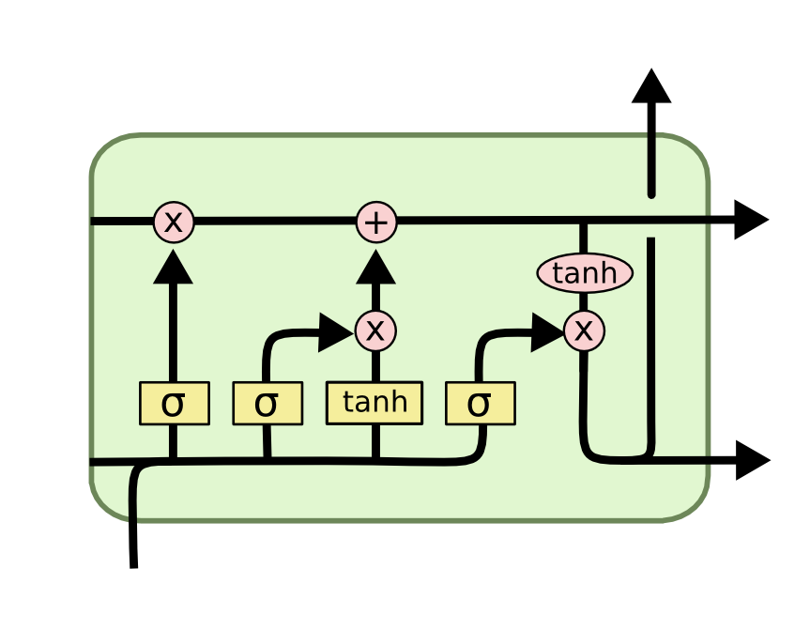
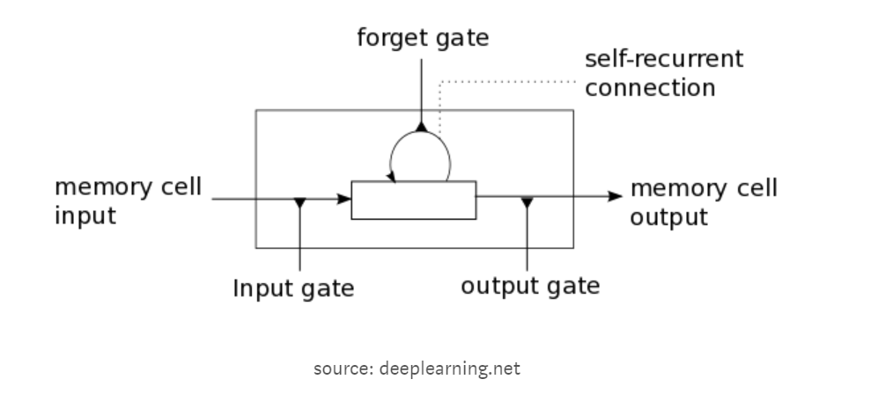
What is an LSTM?
Notes:
This is a variation of the rnn mainly used to take care of the vanishing or exploding gradient problem. LSTMs decide when to keep or erase “memory” based on its importance, and the gates decide when information is allowed to enter or exit.
The good thing about an LSTMs is that they don’t suffer from long-term dependency problems. This occurs when the RNN has to go backwards in the text too many words, and can get lost looking for relevant information. With an LSTM, by introducing forget gates (sigmas) and sigmoid gates (tanh), we only keep retain the relevant information in our RNN’s memory.

Slide 5
What We Did
Import text corpora
Word2Vec
Building the Model
Train and Test
Notes:
So we used a couple of different text collections to train our data, mainly the Gutenburg corpus which contains texts from a variety of ebooks such as Pride and Prejudice and A Tale of Two Cities. Your training data is really important because your model is going to learn from and mimic the writing or speaking styles of whatever text you put into it. In order to input these into our model, we first had to convert to the words to vector format.

Slide 6
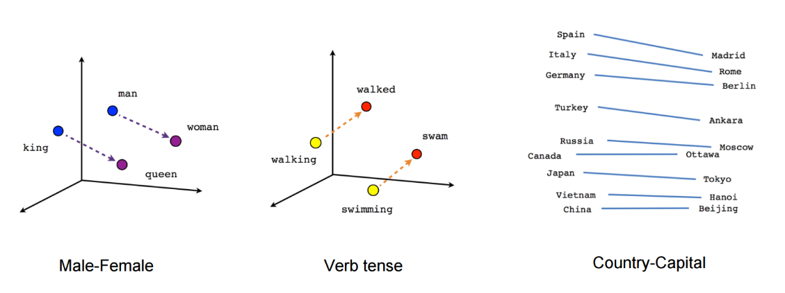
Word2Vec
Source: https://www.tensorflow.org/tutorials/representation/word2vec
Notes:
This is a simple visualization of what Word2Vec does with many less dimensions than what we would actually expect. But Word2Vec basically takes the words and puts them into vector space, and the distances or vectors between the words informs the relationships between the words.

Slide 7
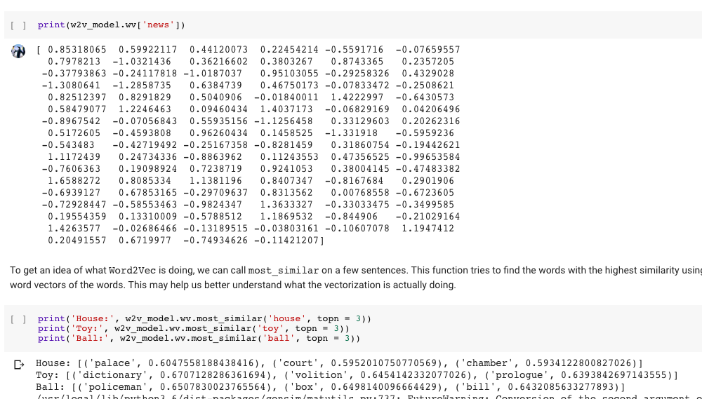
Word2Vec in Action!
Notes:
So our Word2Vec model has 100 dimensions. To illustrate, we’ve called a function to output which 3 words are most similar to the input word.

Slide 8
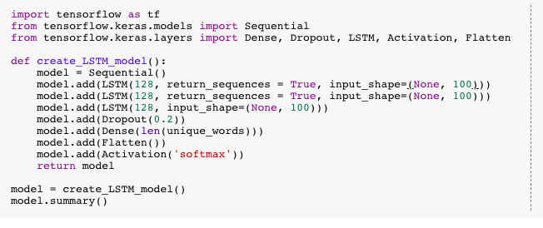
The part of our code that’s interesting
Notes:
This is how we built the model. So we have three LSTM layers inside of our Sequential model.

Slide 9
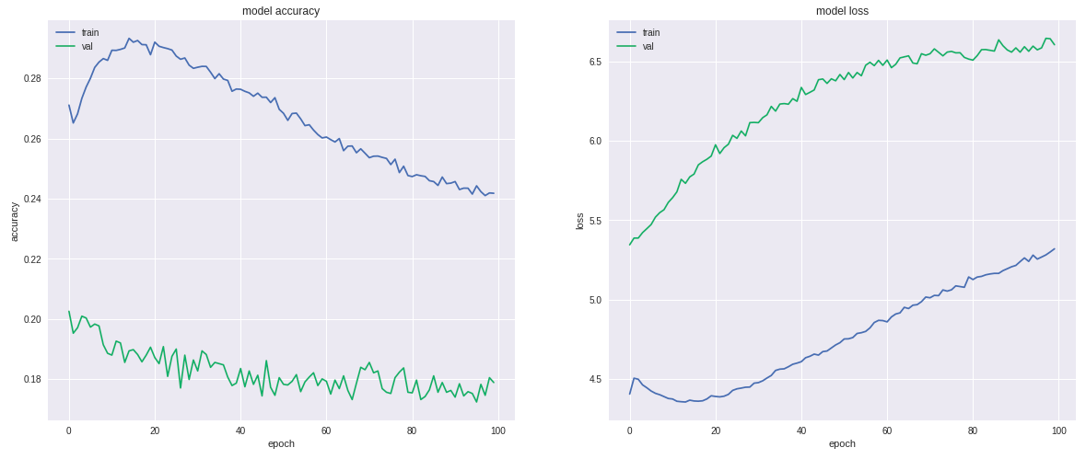
Model with one LSTM layer
Don’t overfit, kids
Notes:
This is from pretty early on in our process when we trained our model with only one LSTM layer. The plots are accuracy and loss graphs for our model plotted against the number of epochs. This kind of helps us visualize if our validation accuracy and loss are improving and what is the optimal number of epochs. This is an example of what you probably don’t want to see.

Slide 10
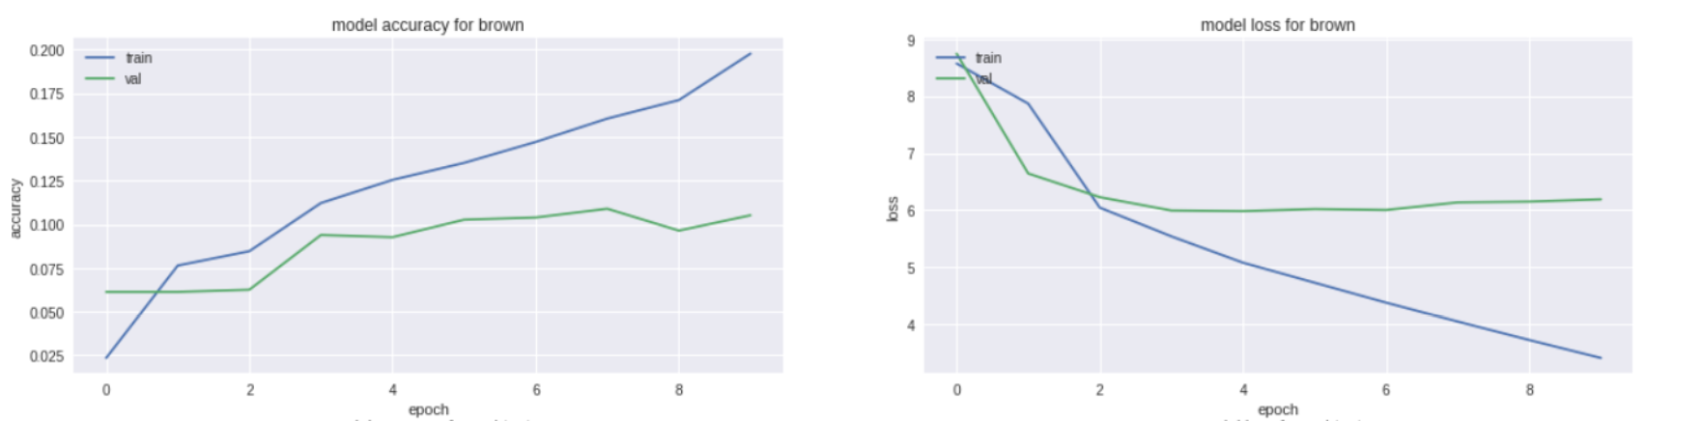
Accuracy and Loss for Brown
Notes:
These are accuracy and loss plots from our model trained with the Brown corpus, which is a compilation of text from 500 sources of varied genre. So here you can see our validation accuracy (green) is generally increasing and our validation loss is generally decreasing, although it tends to bounce back and forth.

Slide 11
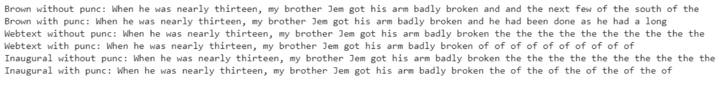
Output
Notes:
Here’s some of the output text we got training our model on different datasets and with or without punctuation cleaning. So these vary a lot in quality, and this could be because of the differing number of words and sentences in the datasets or just the different styles of writing across the text corpora.

